Slide 1
Unveil the obscure network of company and location data, using smart algorithms

Slide 2
Topic to explore:
Own search
Which kind of scenarios / relationships
Where are the data available?
Ontology map (e.g. company address)
Company websites
ERP SAP
Invoice biller to a company
Middleware
Which risks are out there we should consider?
https://www.hackerrank.com/contests/quora-haqathon/challenges/ontology/problem

Slide 3
Notes 09.09.2021
Quick summary of the last call:
Product to deliver to Swiss Re? Tool with UI, searchable Database, Method and they can replicate it
Benefits for them? Tool to checking
To Do:
Susann: dataset with DNB to check and google
OJ: Share the graph inside the slidedeck,Database How to link mother companies and daughter sources including?
Steph: Template of content
Marco: Try out the scrapper on Google Places or Yelp etc., Computer vision on satellite imagery or Street view extraction Satalite vision or computer vision
Prakhar: Maps which are not covered on Street View etc., Normalization script or global, scalable API for street names etc., as well as potentially also for companies in other languages or with different name in other countries for the same company or brand. Try out Selenium or Maps API on the list of companies
To investigate further: Solution Streetview (Script and proof of concept) related to data, Solution: Company website
Deliverables
Sprint 1 DELIVERABLE: PROOF OF CONCEPT with underlying arguments
Sprint 2 Coding and delivering the idea
Ontology: sourcing data on how companies and their locations are connected
Criteria for selection:
Region, Country, Address, Reason to choose a facility
Links shared during the meeting:
https://www.google.com/url?sa=t&source=web&rct=j&url=https://www.mdpi.com/2220-9964/8/4/184/pdf&ved=2ahUKEwimm7PMmfLyAhUuwzgGHcykAmAQFnoECBwQAQ&usg=AOvVaw2eG0AFflxG6w-EtSfN7_GY
I think we can talk a little bit about the secondary problem as well so that we provide a more holistic solution
Check out Slidesgo: https://slidesgo.com/

Slide 4
Notes 05.09.2021
Insights from Reinsurance agent:
Allocate external actuaries to determine the risk
GPT3 and Codex credits and access available
When it is a mother company of holding etc., first look up the subsidiaries in an Ontology best from a global source,
and only then apply the web scrapper or importyeti, https://www.dnb.com/, or computer vision algorithms to Google maps or Google Street View. Geographical repository
Google Street View not covering much of China, India, Arab countries and Africa, can we find other satellite imagery or map data for these areas, such as Maps Me.
Susann: Data set, list of companies that make sense based on DNB, 2te soure (alle Adressen) und die testen wir? reference check
Prakhar: Maps which are not covered on Street View etc., Normalization script or global, scalable API for street names etc., as well as potentially also for companies in other languages or with different name in other countries for the same company or brand. Try out Selenium or Maps API on the list of companies.
Marco: Try out the scrapper on Google Places or Yelp etc., Computer vision on satellite imagery or Street view extraction.
OJ: Graph and Database How to link mother companies and daughter sources including?
Maybe somebody can also start organizing, designing or writing the final presentation more neatly
Database How to link mother companies and daughter sources including?

Slide 5
Table of content
Overview what we plan to do - link companies and properties
Current As Is and to be
Reasons why we choose the sample set
Data source overview
Deliverables Options / Solutions
How can we evaluate the success?
Accuracy/ completeness for our options?

Slide 6
Timeline
Timeline
Initial case: 3 weeks 31 August, 2021‍
Submission of findings & presentation: 20 September, 2021
Strategy creation based on openly sharing all submissions: 27 September, 2021‍
Submission of strategy: 17 October, 2021
Final presentation & Reward Ceremony: 19 October, 2021 Criteria:
• Completeness, • Comprehensibility, • Degree of innovation, • Added value for Swiss Re
Defining the many ways in which a company and a location (for example a factory, warehouse, sales point) can be interlinked
Identifying free or paid source of information, where data would support applying ontology to actual companies and buildings
Populating a first applied ontology with information retrieved from commercially-free data
Potentially retrieving unique identifiers when and where possible, to allow Swiss Re to map it to its internal data at a later stage

Slide 7
Sprint 1 validate the concept, proof of concept
Sprint 1
This sprint is mainly based on ideation, research and the creation of a first use case for a country and industry of your choice (please include the reasoning for choosing a particular geography and industry/sector).
Ideate on ways how to tackle the problem in general
Based on a use case of your choice
Characterize the problem
Analyse existing data by sourcing data on how companies and their locations are connected
Describe a first solution: populate a first applied ontology with information retrieved from commercially-free data
Data may be provided via Github to Swiss Re or any other channel you consider as appropriate. We also expect anon-specialist-readable short document describing the approach, data sets, etc.
After the first sprint, all participating teams will receive the chance to share their method and research results with one another in a joint online event. Based on individual team results, the jury will decide on solidifying individual team’s approaches, licensing additional data and reward distribution for sprint 1. Moreover, the jury will determine which teams will be invited to sprint 2.
How to bridge the data tell us

Slide 8
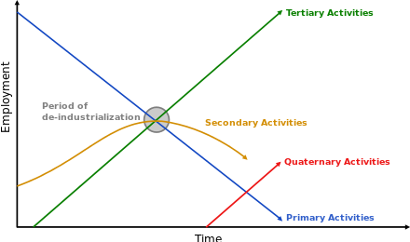
Sample Set based on three sector model of fourastie
One classical breakdown of economic activity distinguishes three sectors:[1]
Primary: involves the retrieval and production of raw materials, such as corn, coal, wood or iron. Coalminers, farmers and fishermen are all workers in the primary sector.
Secondary: involves the transformation of raw or intermediate materials into goods, as in steel into cars, or textiles into clothing. Builders and dressmakers work in the secondary sector.
Tertiary: involves the supplying of services to consumers and businesses, such as babysitting, cinemas or banking. Shopkeepers and accountants work in the tertiary sector.
In the 20th century, economists began to suggest that traditional tertiary services could be further distinguished from "quaternary" and “quinary” service sectors. Economic activity in the hypothetical quaternary sector comprises information- and knowledge-based services, while quinary services include industries related to human services and hospitality.[2]
Tertiary: Agriculture, Raw materials
Secondary: Manufacturing
Tertiary: Services
Quaternary: Service, Consulting
Economic sector - Wikiwand

Slide 9
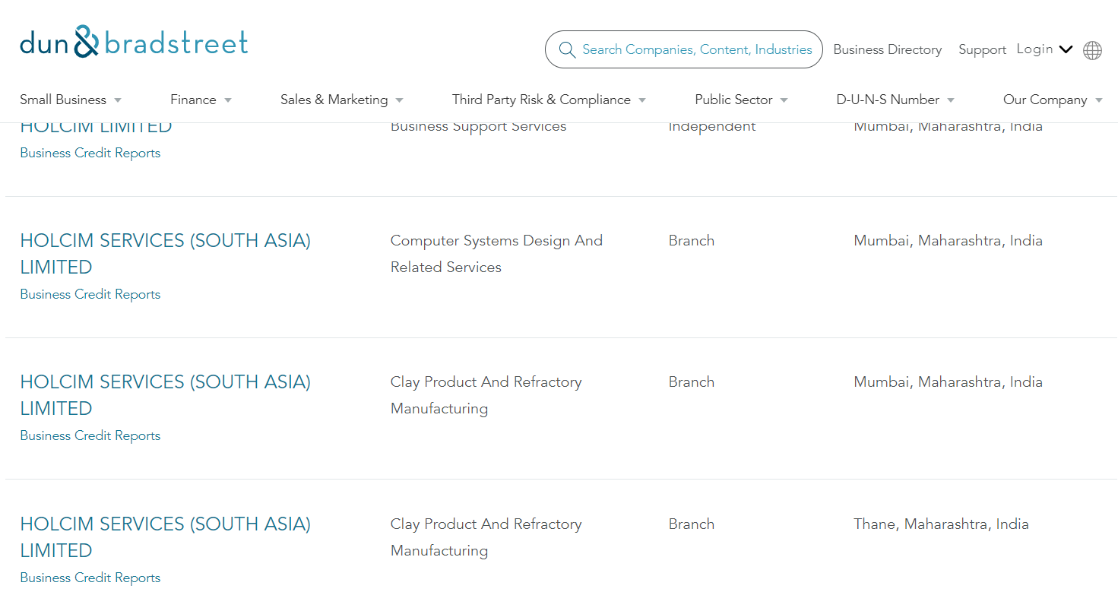
Sample Set additional criteria and global company player with a diverse footprint in industry
Worldwide availability and several locations - information from local company/corporate websites
responsibility to report data as listed on stock market: data source company reports (annual, sustainability)
General risk factors a company is dealing with: location factors: human development, infrastructure (railway, pipeline), natural catastrophes
Data sources: weather forecast (swiss meteo), Human Development Reports | United Nations Development Programme (undp.org), About - Transparency.org, Latest Earthquakes (usgs.gov)
Access to satellite information: googlemaps, bing, maps me
Country regulations: China, Vietnam Google and Google Maps do not work or proplery
Country risks: The World Factbook - The World Factbook (cia.gov)
Status of a country (rule of law example: Permesiv Switzerland/Great Britain, semi permesiv: Russia; non permissive: Afghanistan)
GDP related
Economic sector - Wikiwand

Slide 10
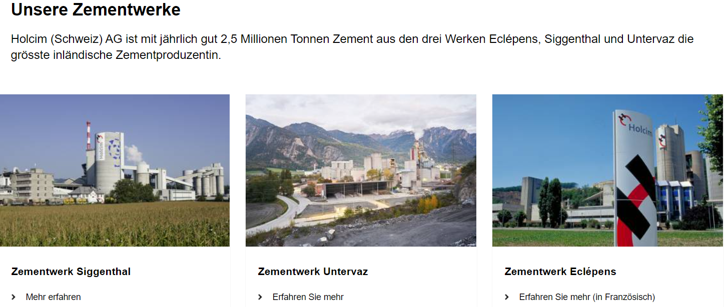
Ideas of companies Lafarge Holcim: worldwide, divers localizations, risks and businesses)
Primary sector: mining of gravel and cement and other primary raw materials
Secondary Sector: Production of concrete
Tertiary Sector:

Slide 11
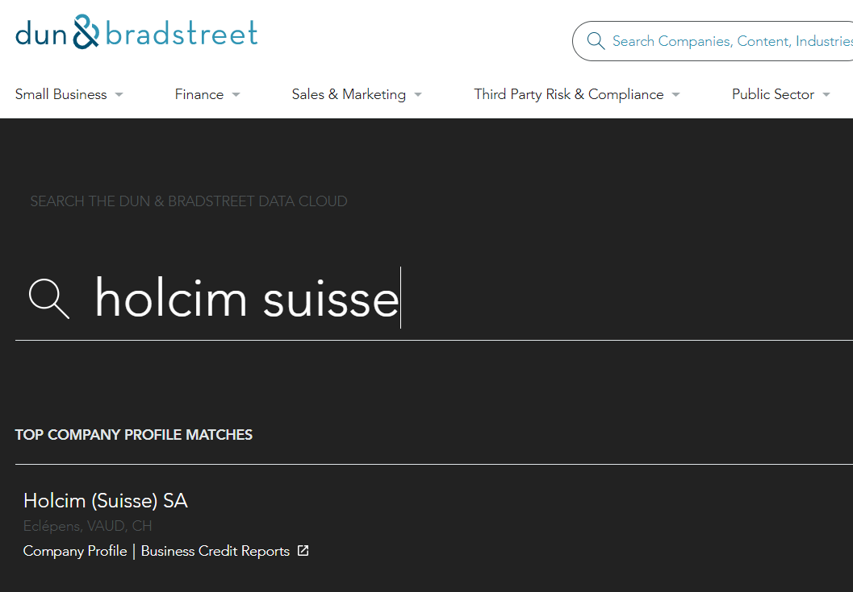
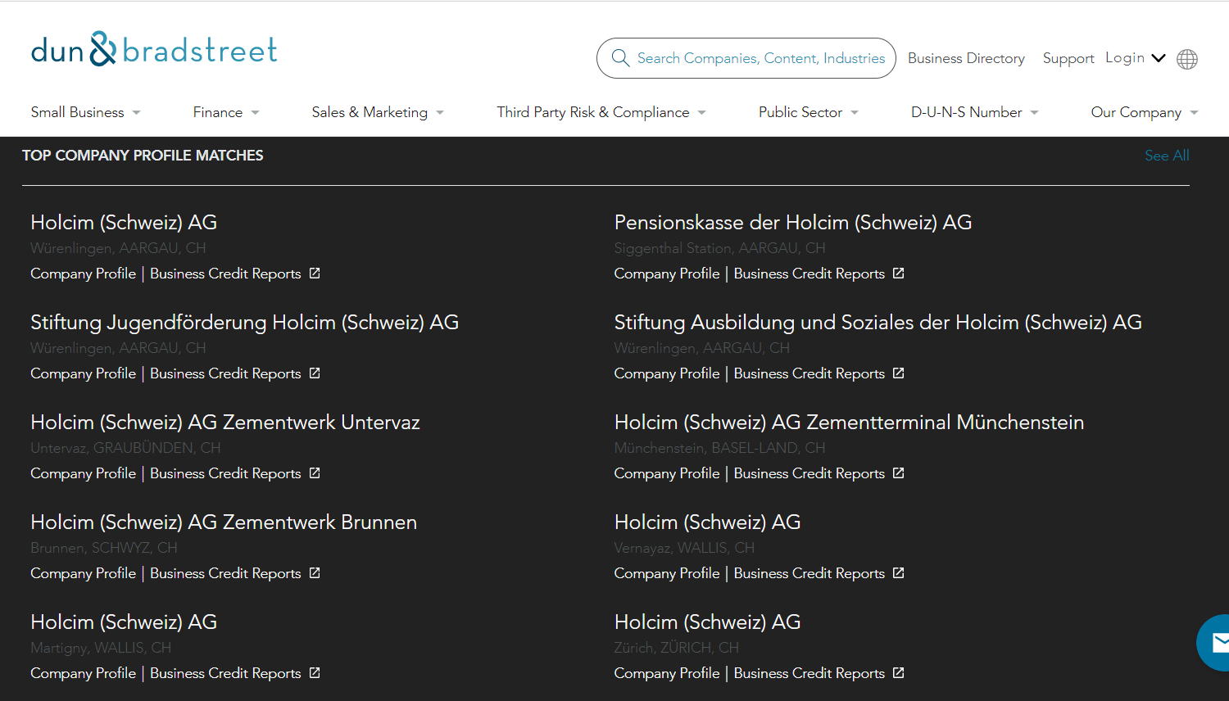
Ideas of companies Lafarge Holcim: worldwide, divers localizations, risks and businesses)
Test Duns & Bradstreet website - three cement manufacturer in switzerland
googlemaps: Search with name Holcim Schweiz AG only 2 hints

Slide 12
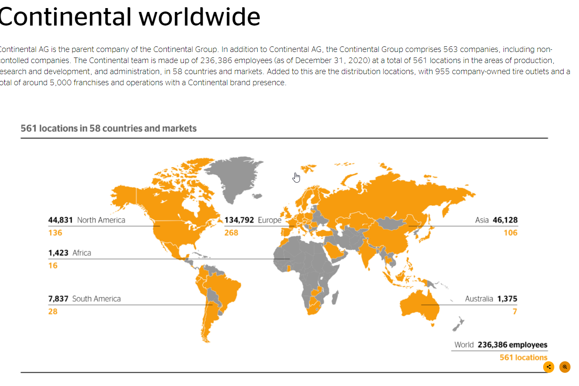
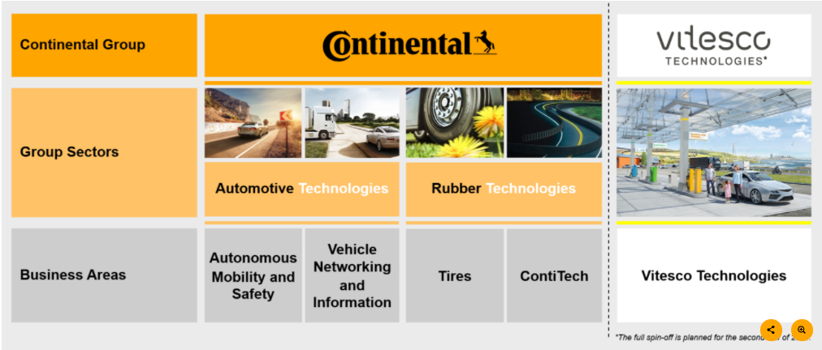
Continental AG & Vitesco: Divisional view on activities
Automotive: Autonomous Mobility and Safety business area develops, produces and integrates active and passive safety technologies and controls vehicle dynamics. The product portfolio ranges from electronic and hydraulic brake and chassis control systems to sensors, advanced driver assistance systems, airbag electronics and sensors (Commercial Vehicles and Services, Connected Car Networking, Human Machine Interface)
Tires business area stands for innovative top performance in tire technology
The products, systems and solutions developed by ContiTech are used both in the automotive industry as well as in railway engineering, machine and plan construction, mining, agriculture and other important sectors of the future.

Slide 13
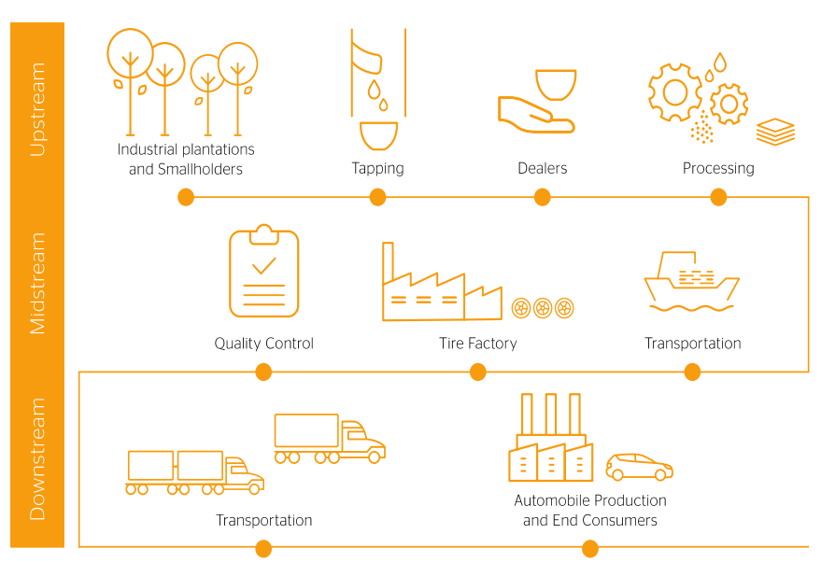
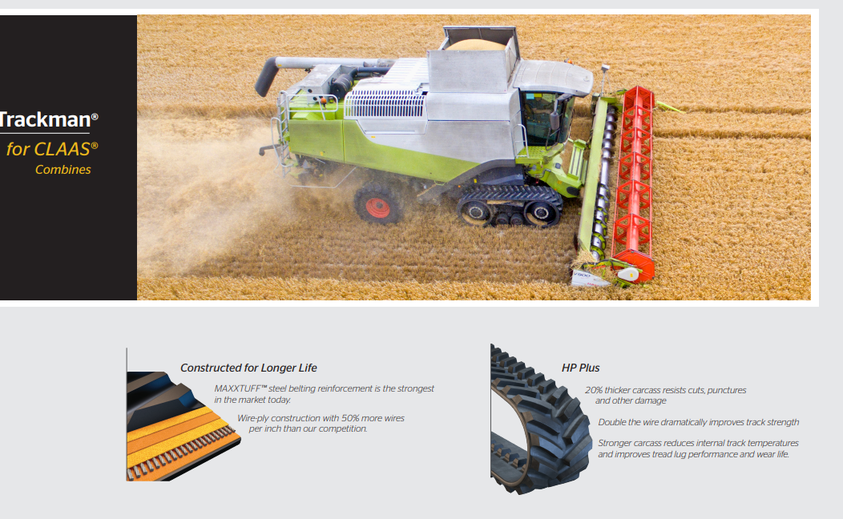
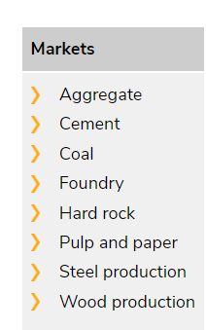
Ideas of companies Continental Secondary Industry Tire, belt production of natural rubber
Secondary Sector: Production of tires for cars, LKW, belts
The market for truck tires offers particularly great potential for the new material: a tire weighs 70 to 80 kilos, of which 30 to 40 percent is natural rubber
Ideas: Local farms of dandelion
.
Sources: FIRE (continental.com) Continental Sustainable Natural Rubber Sourcing Policy Fortress XP < Textile Conveyor Belts < Material Handling | Continental Industry (continental-industry.com) Gummiraupenketten < Kettenlaufwerke < Produkte & Lösungen | Continental Industry (continental-industry.com)

Slide 14
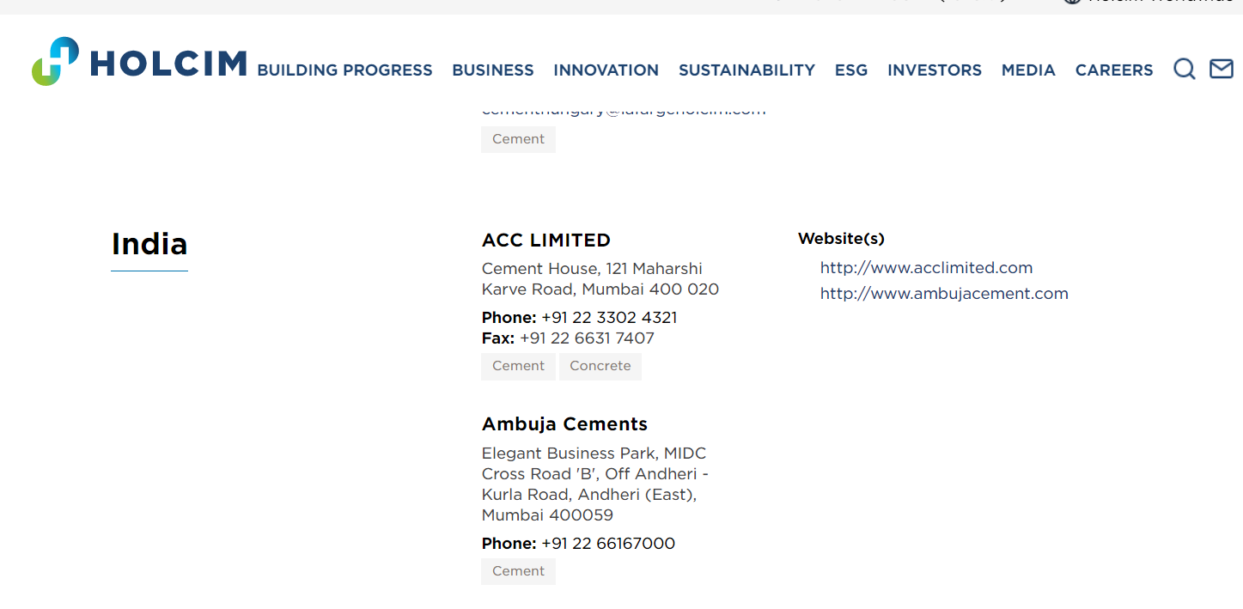
Limitations
Availability of adresses: Streetview, googlemaps is limited, Satellite is available worldwide, open street map is limited -> solution could be to check maps.me
DNB database looks up the information the key word search is the limitation and the solution is the information mapping based on DUNS number (it is a paid version)
Challenge with the Name of a company Lafarge & Holcim how to overcome: -> Company website or on annual report, chamber of commerce
Ambhuja Cement Limited 501, Cross Rd B, Bhim Nagar, Andheri East, Mumbai, Maharashtra 400047, Indien & Holcim Holcim has substantially increased its stake in Ambuja Cements in India | Holcim.com
.

Slide 15
Cement Industry
How do they differentiate?
Kamine?
.

Slide 16
sourcing data on how companies and their locations are connected
Database / Source | Type of Information
Google maps or Google Street View, google earth | Computer vision on satellite imagery or Street view extraction
maps.me, yelp, bing | Computer vision on satellite imagery or Street view extraction
yelp | Computer vision on satellite imagery or Street view extraction
Duns and Beadstreet dnb.com
Companies website | Subsidiary and parent company information, address code annual/ quarterly reports
chamber of commerce moneyhouse zefix.com | information on official listed companies
placekey.io/blog/adress-matching | way how to solve it
importyeti.com | supplier and companies/manufacturer information
https://www.google.com/url?sa=t&source=web&rct=j&url=https://www.mdpi.com/2220-9964/8/4/184/pdf&ved=2ahUKEwimm7PMmfLyAhUuwzgGHcykAmAQFnoECBwQAQ&usg=AOvVaw2eG0AFflxG6w-EtSfN7_GY | Graph
https://www.esri.com/en-us/industries/facilities/overview
The World Factbook Archives - The World Factbook (cia.gov) | Information on countries

Slide 17
Deliverables Options
Searchable Database with data on a company
Pros: Easier than the tool to build
Cons: Maintaining the db could be a bit more complicated. We would have to restrict to location or specific domain of countries.
Tool with UI - Scrape a website for a particular company and then run a mapAPI on the data
Pros:
Easier for them to use and gets all perfect output format
Cons:
Much more programming intensive for us
Methodology and steps - What can they do and provide an example or walkthrough.
Pros:
Less programming intensive for us
Can be very flexible
Cons:
Not a very tangible outcome because it’s more theoretical in nature

Slide 18
Get information about a company’s suppliers
I found a website which can list (almost) all the suppliers of a company along with the location of the manufacturers along with the number of shipments and dates.
Website Link:
- https://www.importyeti.com/company/
https://www.dnb.com/
This information can be scraped from the dun&bradstreet or also the ImportYeti website with a python scrapper or a platform, such as ParseHub. We can merge it with a Selenium script to input some text in the search and then scrape the corresponding output.
Further we can plot these locations on a map or a heat-map to visualise the locations or the quantity of supply.
We can also track instances of political or other unrest in these supplier nations to see, if there is a logistical risk involved (delay of shipments, increase in tariffs etc.)

Slide 19
Location of buildings related to a company
We want to find the address of buildings or warehouses which might be related to a company in a particular region through satellite imagery from Google maps, open source maps where Google maps is not available or private companies, such as from the nanosatellites from Planet Labs.
We can find the various locations of a company around the globe. Thanks to object identification algorithms, such as recent YOLO versions, convolutional or transformer-based solutions, taking into account the distances of the different orbit image satellite or drone photographs we can also provide locations of factories or tech parks that have a fence or wall around, and through this multiple buildings or factories of a company inside it. Similarly, for other domains, such as electricity or other power providers tag/label the network of, for instance electricity towers and their start and end buildings.
Furthermore, we can perform Computer Vision on Google Earth/Street View together with NLP multi modally via a jupyter notebook we have built using for instance the Sagemaker APIs to extract company names from the building names and entrance inscriptions, and match it with what we have to complete the list of buildings that may be away from the others or detached.
We can then find their exact location using the GMaps API.
Notes:
yes, I have added some info

Slide 20
Secondary Problem: Normalization
For the secondary problem of normalizing address names, we can use fuzzy logic for address matching or similar address matching methods, such as APIs to find the closest address to the one mentioned and with a probability score for how close they are. The accuracy can also be enhanced further via modern NLP or bi-modal pattern matching methods.
This can be combined with the Google Maps or Bing APIs to find the corresponding location and coordinates.
The coordinates can then be stored in a database or ontology. This process can be made as a real-time service using Python scripts.

Slide 21
Sprint 2
Sprint 2
One of the main challenges will be how to transpose a concept from one region/industry to another and hence generalize. There might be significant differences in availability of data (take the U.S. for example that generally has lots of data available which might not be the case for other countries). In sprint 2 the emphasis will be on transforming your gained knowledge towards a global, scalable approach which translates into tangible business benefits.
Workshop with talent teams, Swiss Re and Mindfire to frame the 2nd sprint and shape deliverables of 1st sprint to be suitable as input for the 2nd one
Create a first reusable model (based on a specific industry, region)
Implement your model – workable prototype
Describe your solution/way in a concept supported by a data flow/logic of the model visualization OR code

Slide 22
Country and industry
a country and industry of your choice (please include the reasoning for choosing a particular geography and industry/sector).
Ideas: Fortune 500, DAX 30, SME to have a regional based sample Six Swiss Exchange
Biggest top 20 Indian companies
Companies publish annual/ quarterly reports
Sustainability Reports
Joint venture information website
# search on Facebook, Instagram
https://www.marklines.com/portal_top_en.html
https://www.strategyanalytics.com
https://www.foodengineeringmag.com/2019-top-100-food-beverage-companies
WHO has information ? https://datarade.ai/data-products/location-data-matrixian-group
Banks, middleware for payment (SIX), SAP,

Slide 23
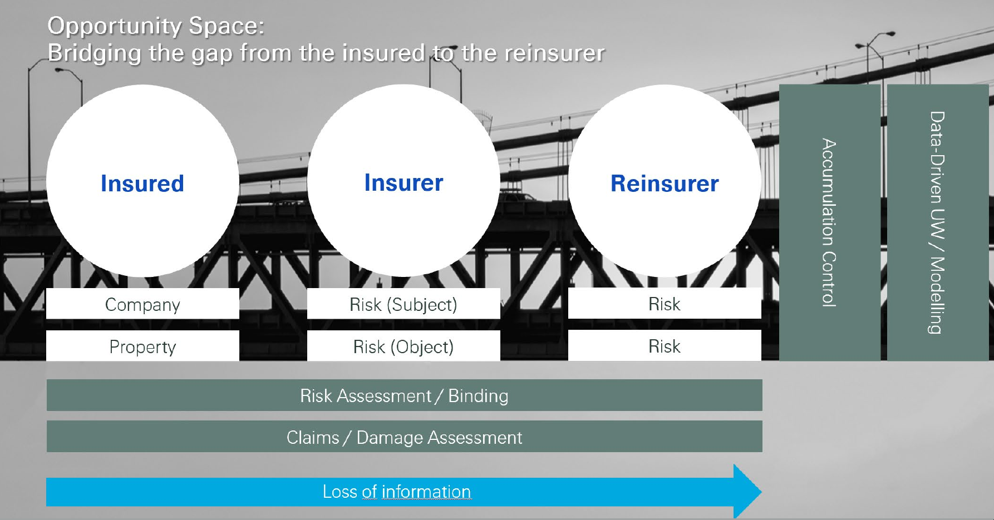
Which data – e.g. address
Define a scope
Company ABB and a location e.g. fortune 500, SME

Slide 24
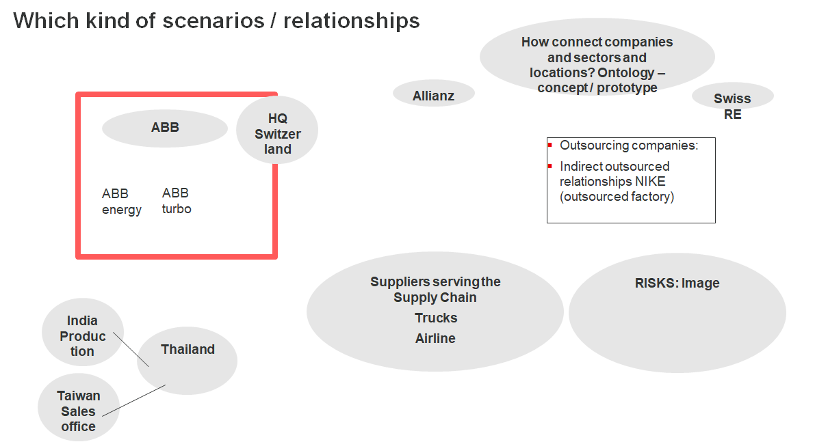

Slide 25
Which data – e.g. adress
Define a scope
Company ABB and a location e.g. fortune 500, SME

Slide 26
Enterprise Risk map Detailed risk overview/ protocol description- in the back up
Risk legend:
A | US sanctions
B | China dependency (specifically Manmade Fibers)
C | Global Tax policy impact
D | Additional waves of Covid-19 infections and additional global lockdowns
E | Cyber risk & Data protection
F | Trade disruptions due to Brexit
G | US / China trade conflict: China further limiting the US content they allow in imported products (i.e. Software, etc.)
H | US / China trade conflict: US further raising tariffs and complicating exports from China to US
I | Fraud (Treasury)
J | HSE / Permits / Compliance
K | Catastrophic failures of products / services
high
G
D
C
50%
(10-20m)
(40-90m)
(50-110m)
(120-170m)
A
H
E
Likelihood
B
medium
(10-15m)
(20-50m)
(90-180m)
20%
I
(5-15m)
F
K
low
J
(0-50m)
(200-300m)
(< 10m)
Insurance coverage
Gross view (before mitigation actions)
CHF 50m
CHF 100m
CHF 500m
Stable
Increasing
Decreasing
Impact on Enterprise Value (range)
low
medium
high
Strategic
Compliance
Operational
Financial

Slide 27
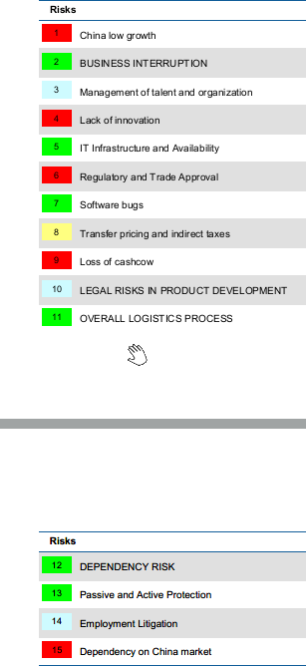
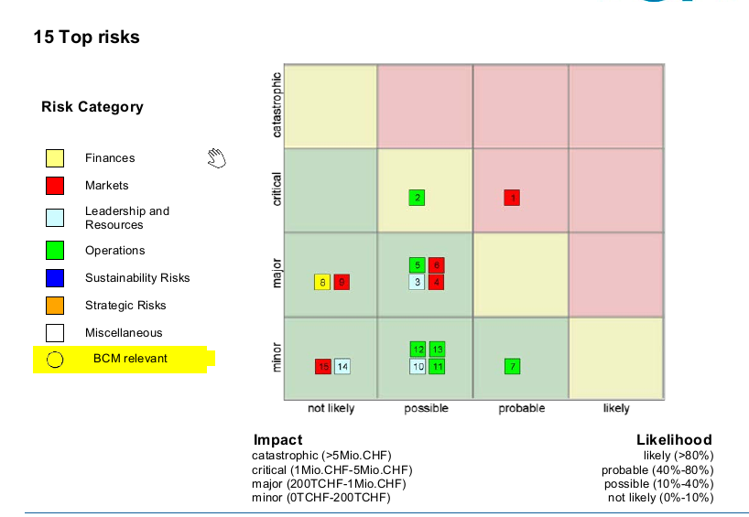
Local / regional risks

